Slide 1

Defining Your Own Stylesheet

Slide 2
Reference: The Docs
http://matplotlib.org/users/customizing.html
and
http://matplotlib.org/users/style_sheets.html#style-sheets

Slide 3
Case Study: Publication
Dodds, et al., publish Human language reveals a universal positivity bias in PNAS.
Refuted by Garcia, et al., in The language-dependent relationship between word happiness and frequency.
Goal: Show that three datasets of word positivity are correlated!

Slide 4
Plot the three datasets

Slide 5
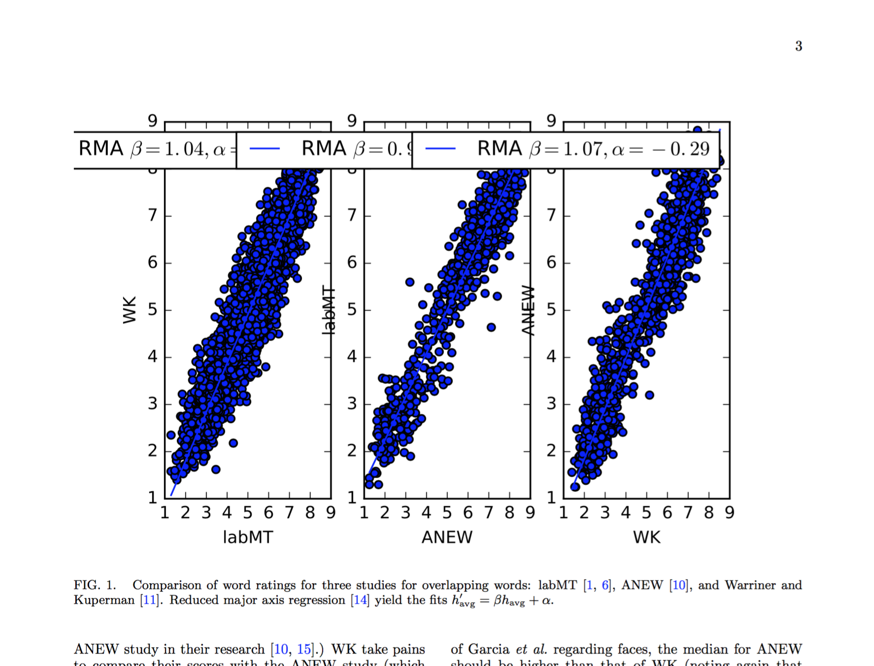

Slide 6
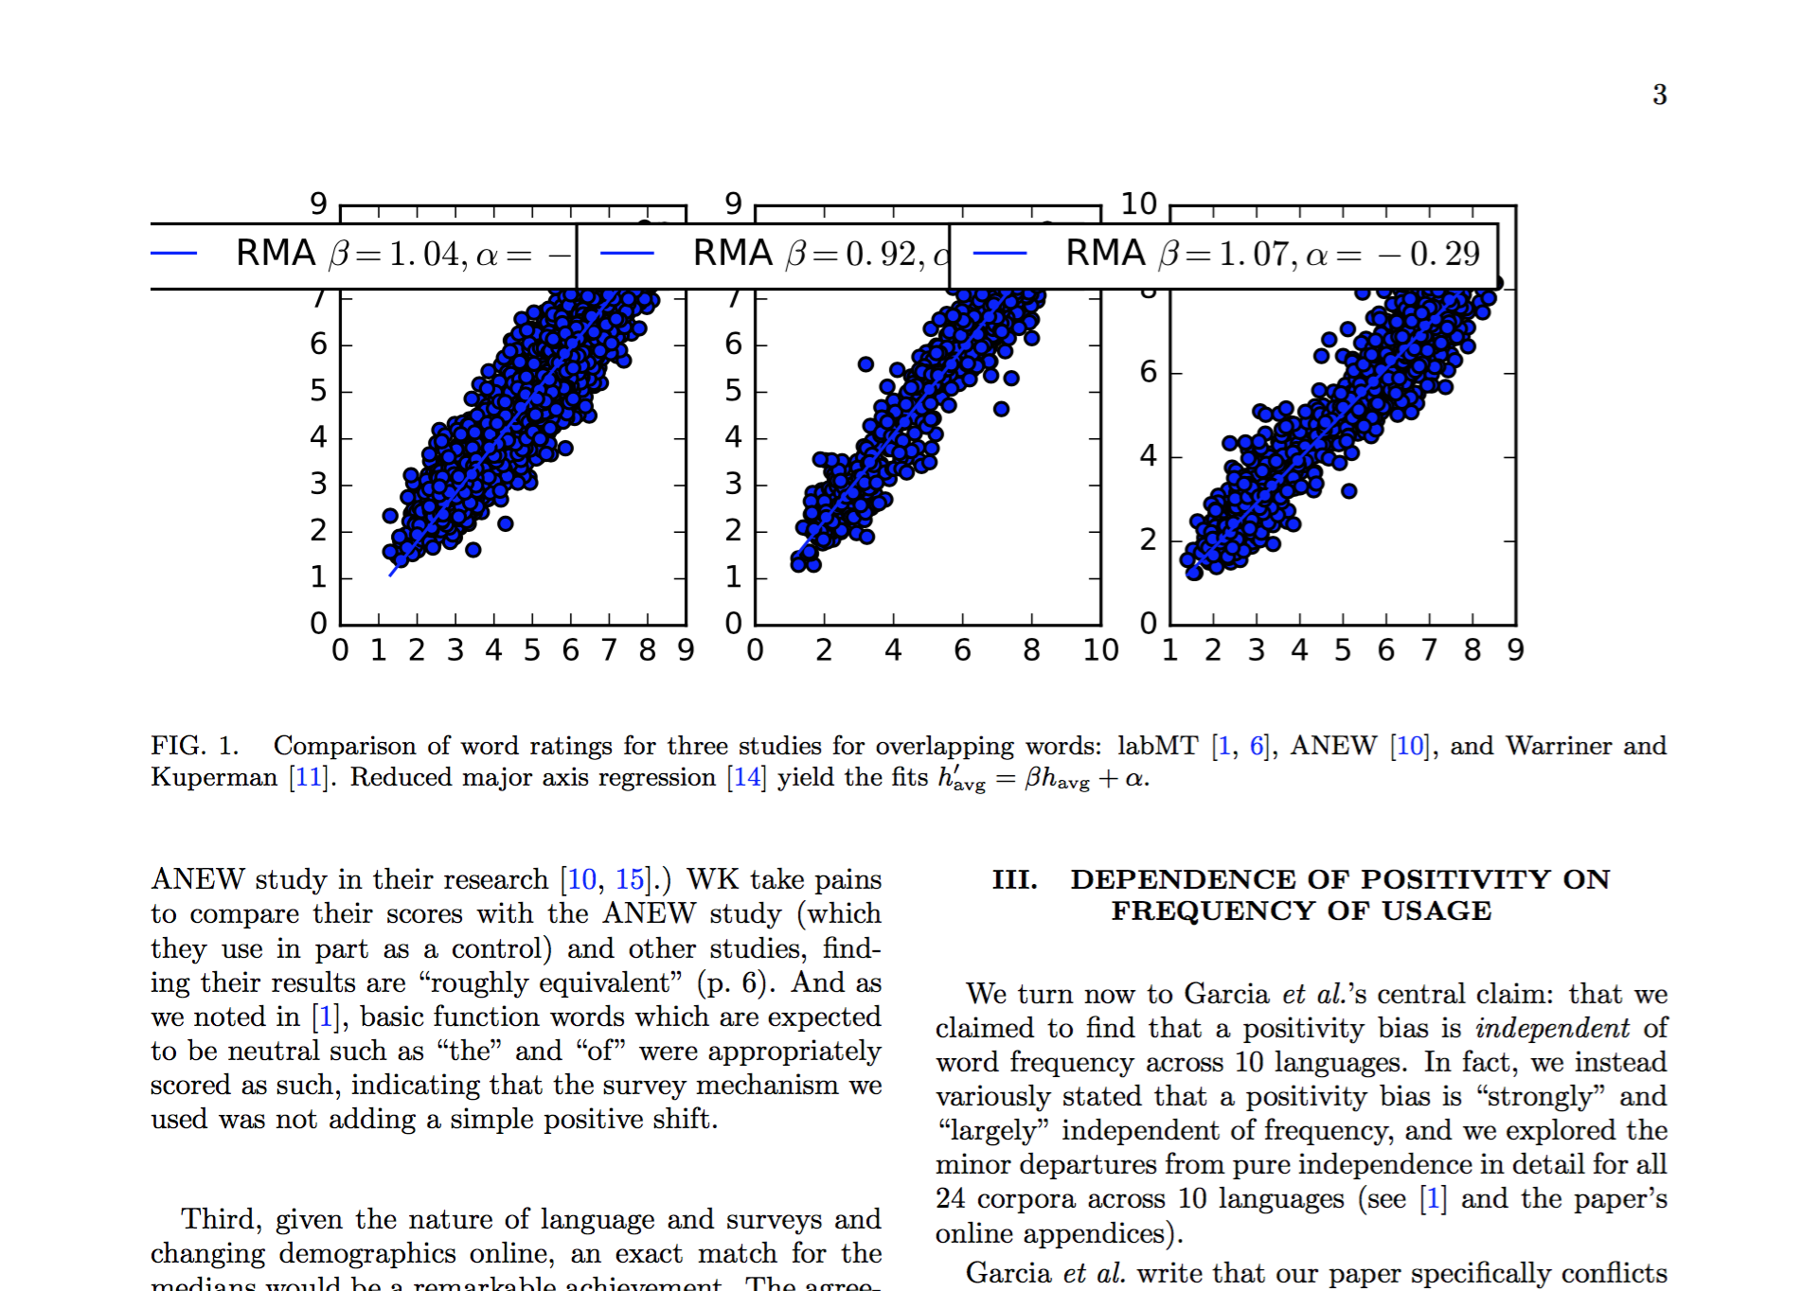

Slide 7
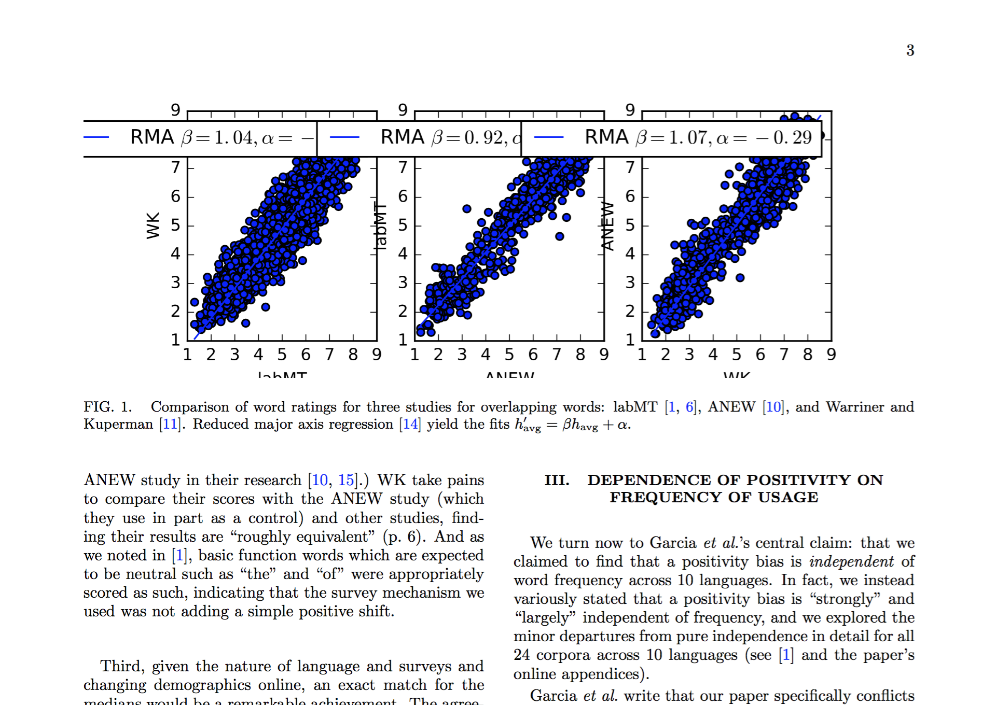

Slide 8
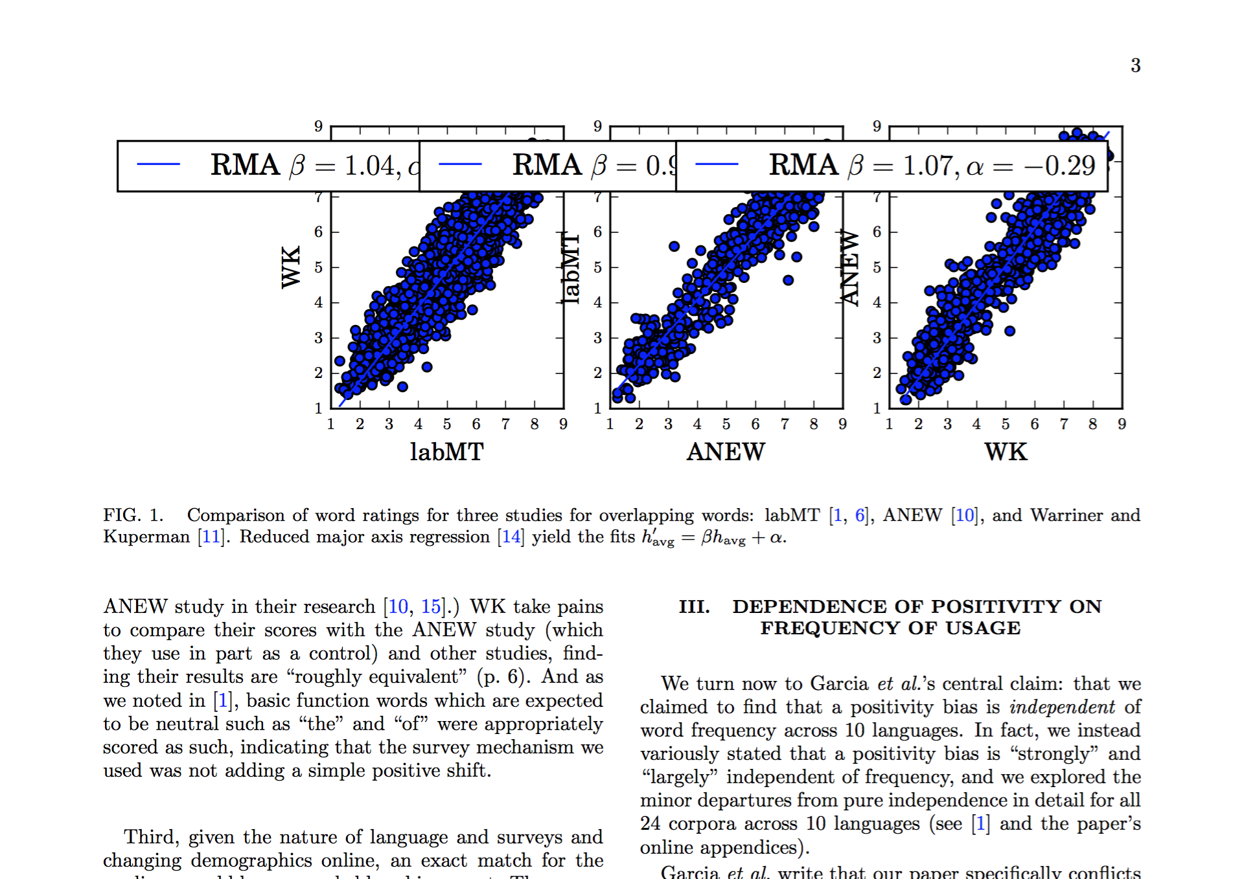

Slide 9
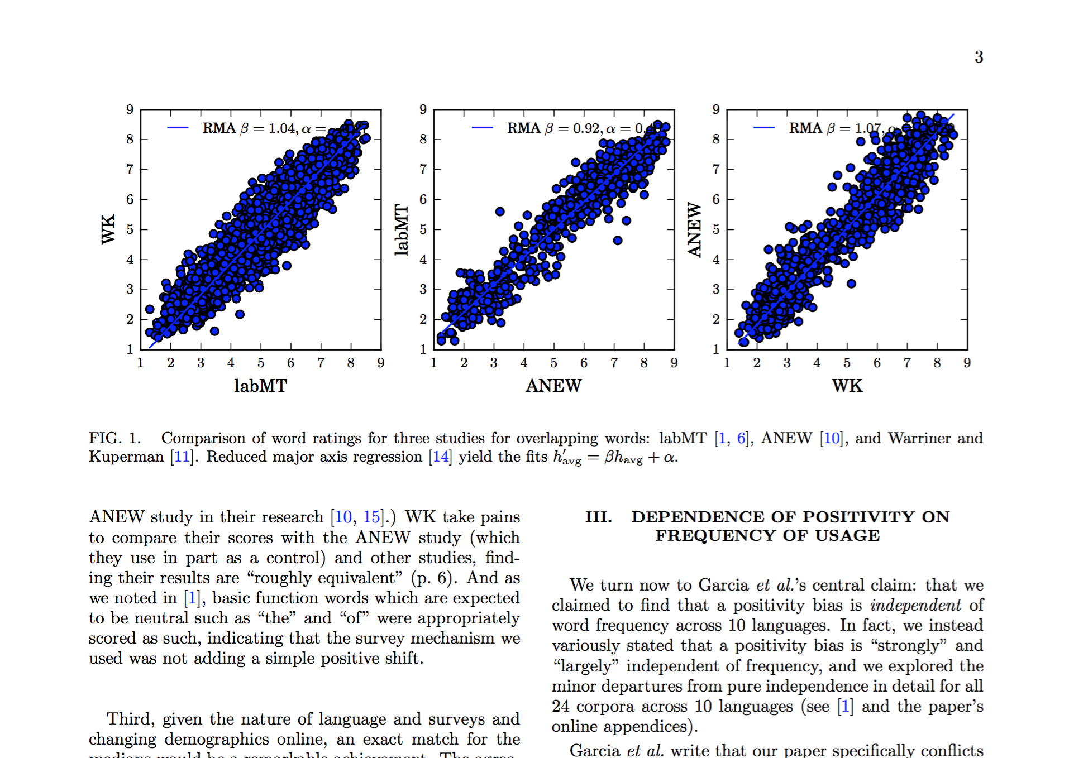

Slide 10
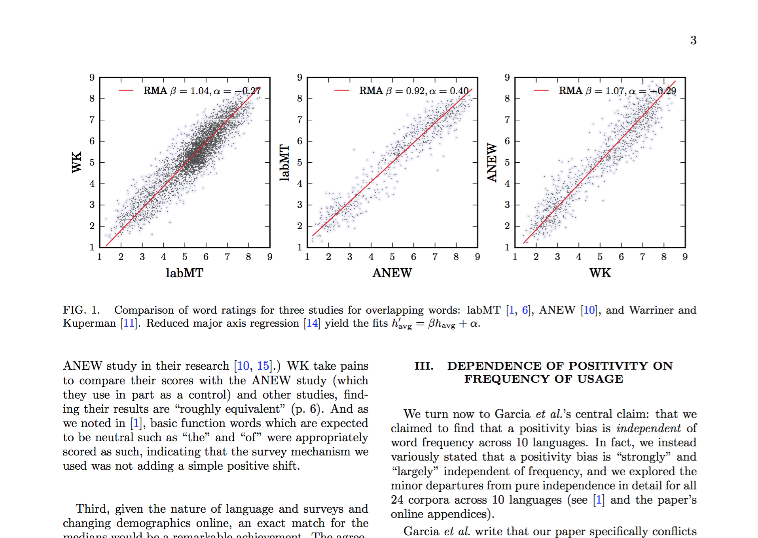

Slide 11
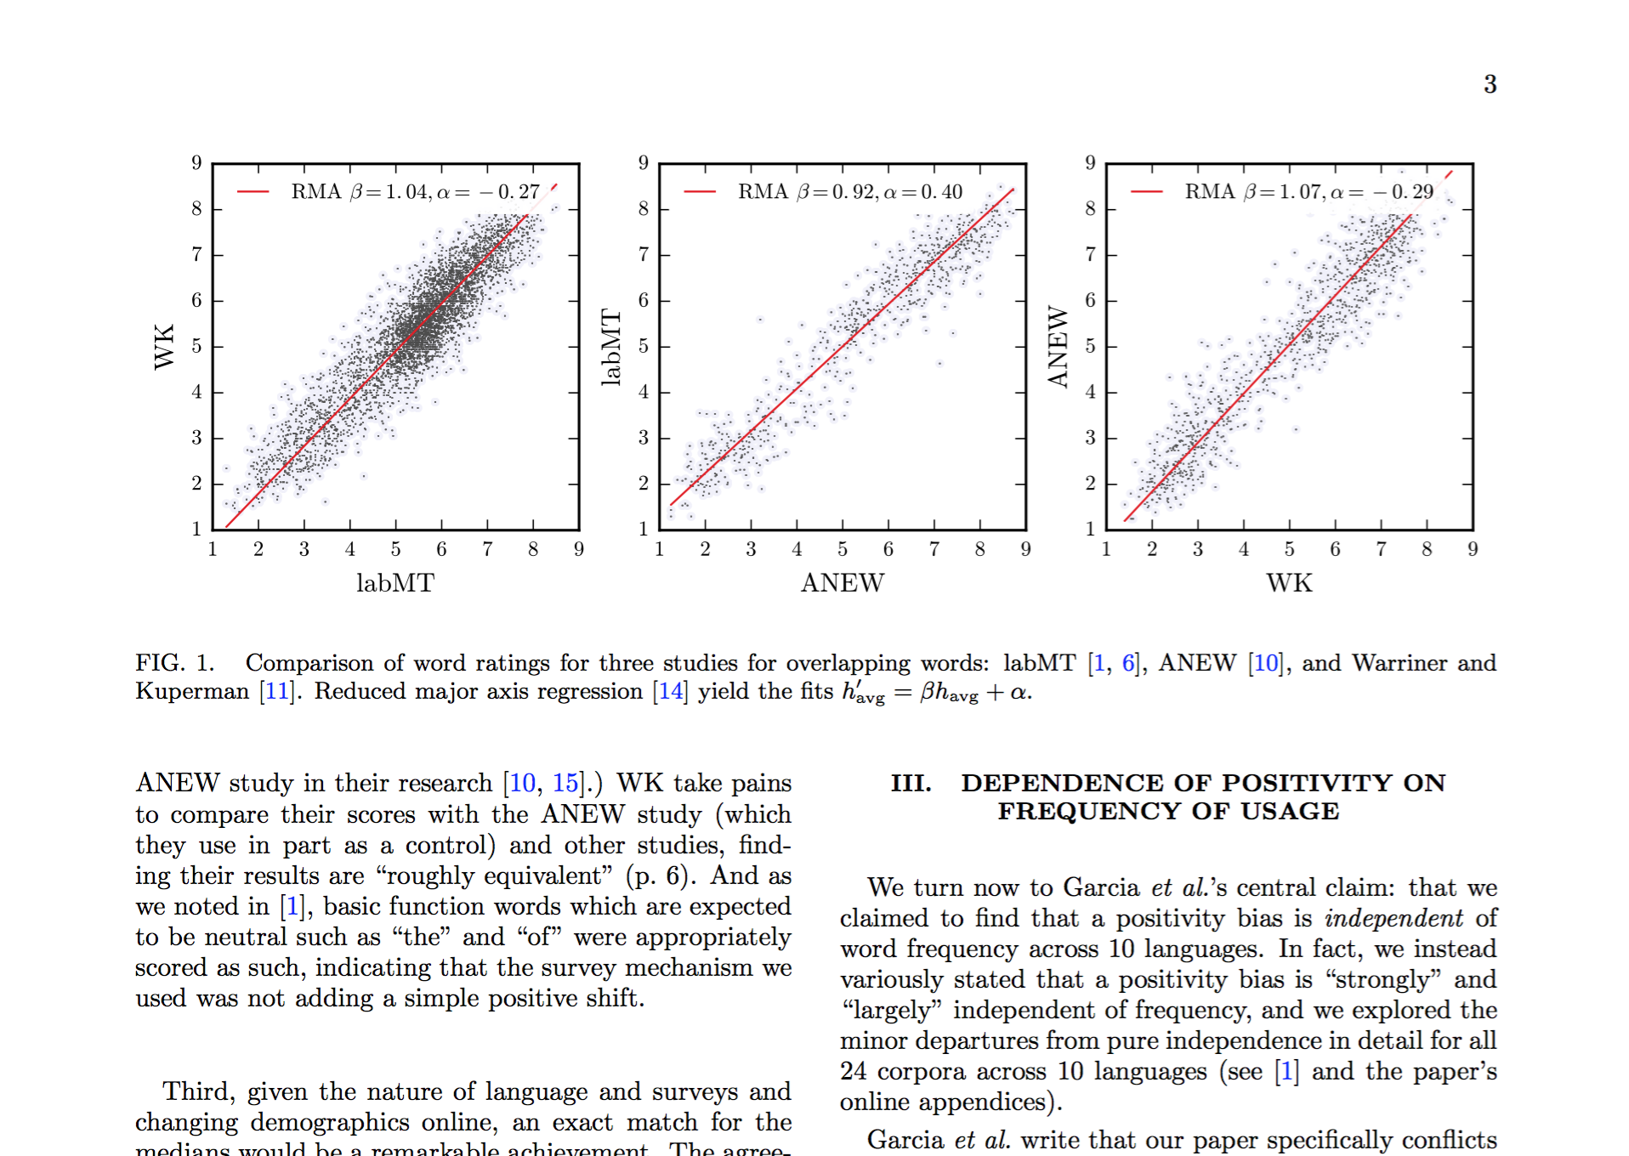

Slide 12
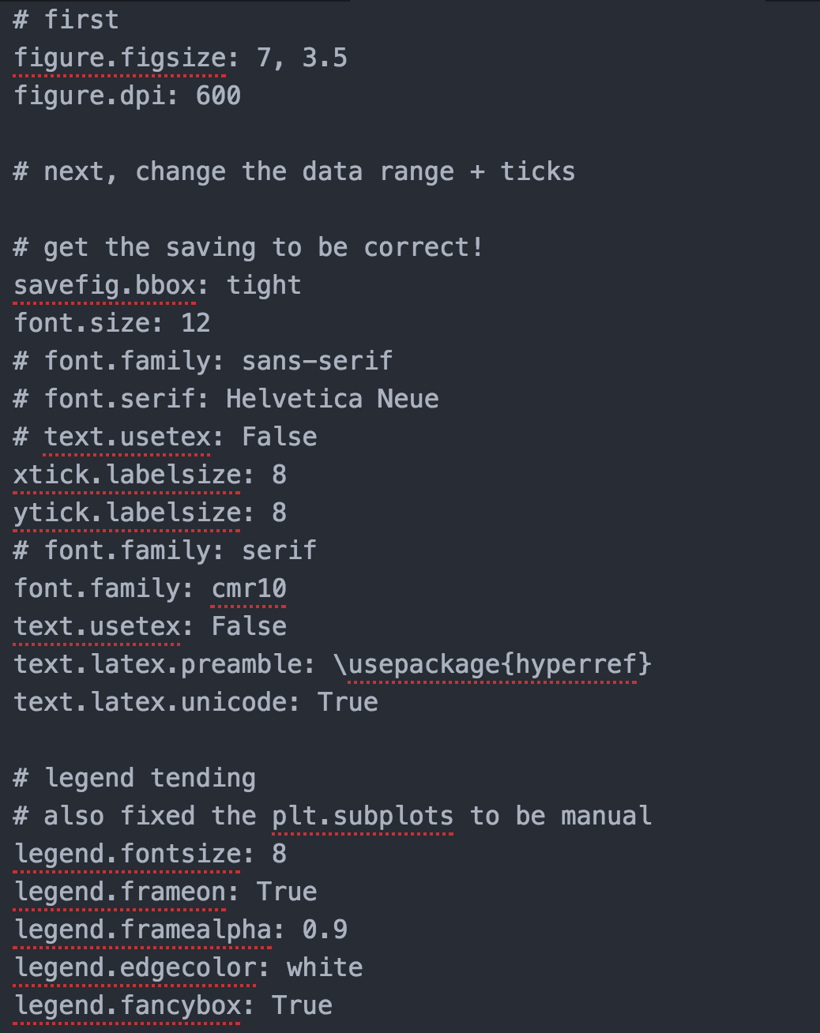

Slide 13
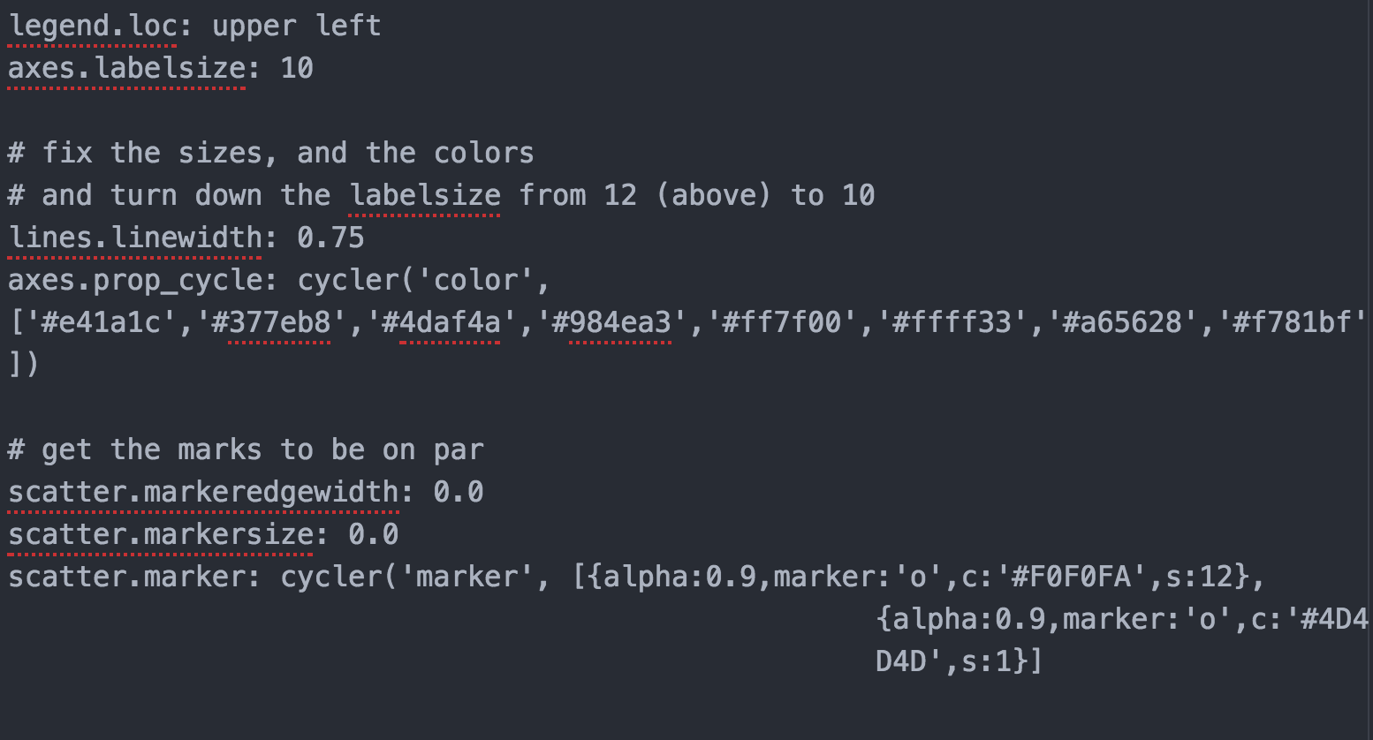

Slide 14
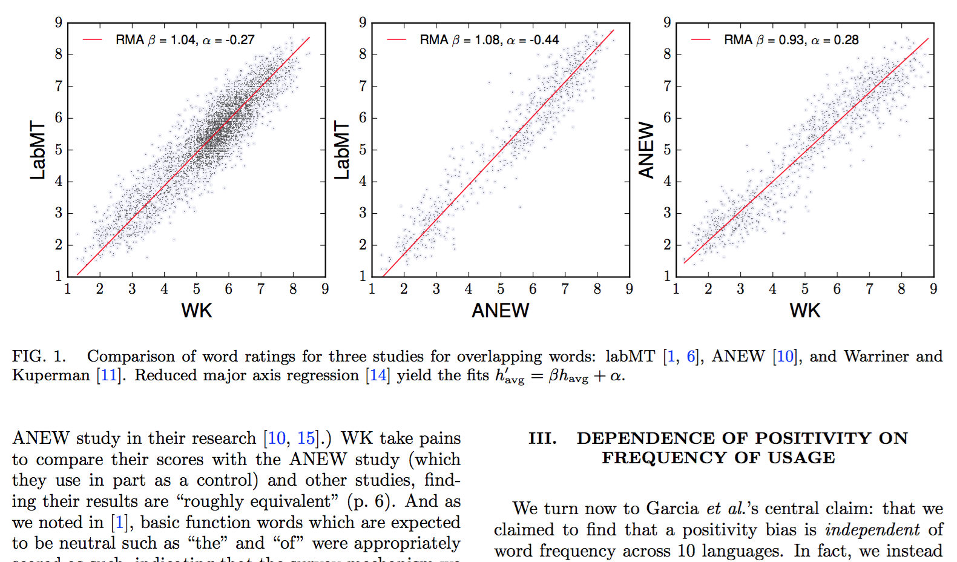
Published

Slide 15


